Slide 1
INTER-AMERICAN DRUG ABUSE
CONTROL COMMISSION
C I C A D
Secretariat for Multidimensional Security
SEVENTIETH REGULAR CICAD SESSION
November 16th-19th, 2021
Virtual Session
OEA/Ser.L/ XIV.2.70
CICAD/doc.2635/21
November 17, 2021
Textual
MARYA HYNES
PLENARY SESSION 4
REPORT ON DRUG SUPPLY IN THE AMERICAS EXECUTIVE SUMMARY

Slide 2
ORGANIZATION OF AMERICAN STATES (OAS) INTER-AMERICAN DRUG ABUSE CONTROL COMMISSION (CICAD) REPORT ON DRUG SUPPLY IN THE AMERICAS Executive Summary

Slide 3
The Inter-American Drug Abuse Control Commission

Slide 4
The Inter-American Observatory on Drugs

Slide 5
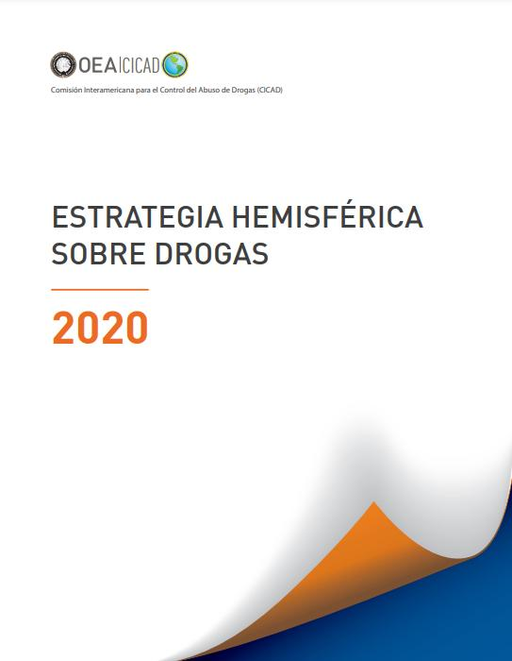
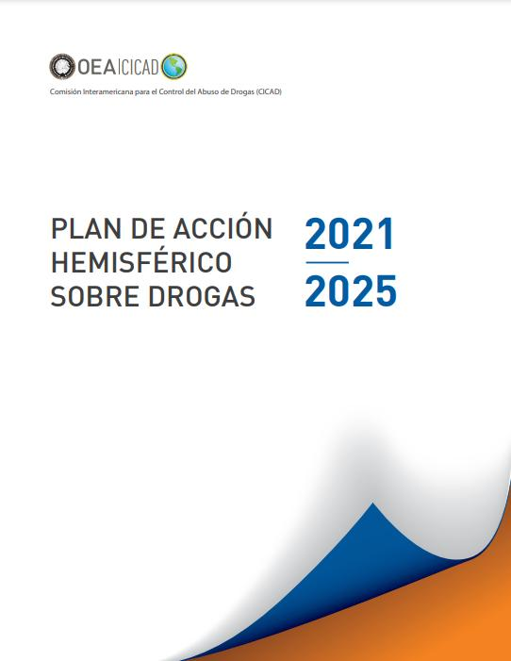
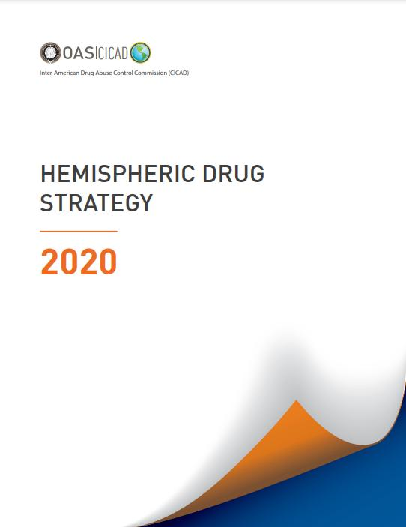
The OAS Hemispheric Drug Strategy 2020 and Hemispheric Plan of Action on Drugs 2021-2025
“Expand and enhance the collection and dissemination of information on illicit drug production, trafficking, and related issues, through the use of sound, systematic data collection practices, scientific research, and standardized methodologies."

Slide 6
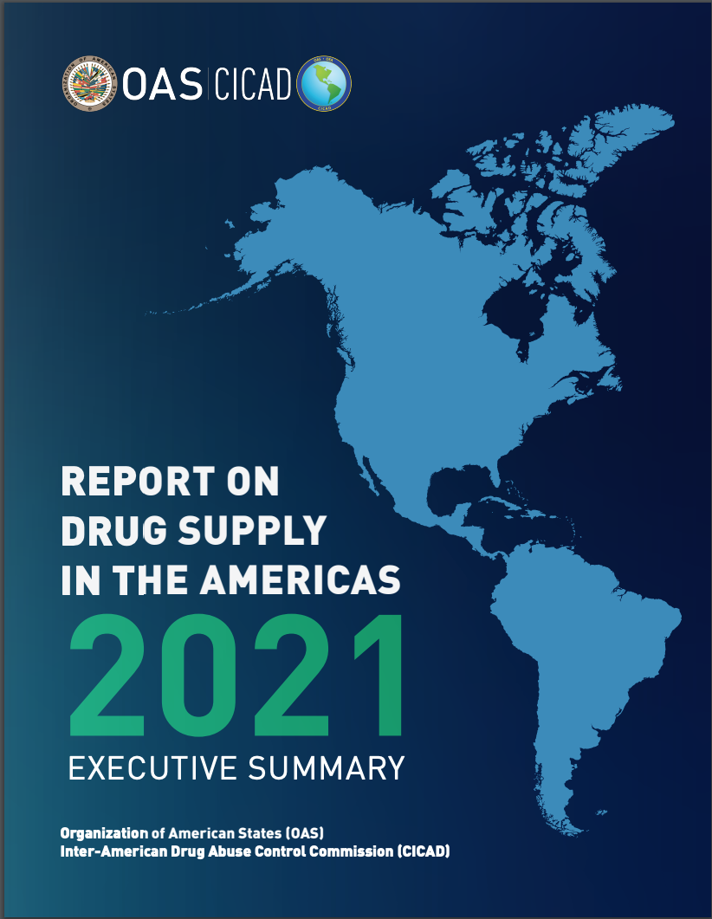
The report provides an overview of drug supply across the Hemisphere based on data submitted by OAS member states.

Slide 7
Countries that submitted data for this report
Antigua and Barbuda
Argentina
The Bahamas
Barbados
Belize
Bolivia (Plurinational State of)
Canada
Chile
Colombia
Costa Rica,
Dominica
Dominican Republic
Ecuador
El Salvador
Grenada
Guatemala
Guyana
Honduras
Jamaica
Mexico
Paraguay
Peru
The Federation of St. Kitts and Nevis
Saint Lucia
Suriname
Trinidad and Tobago
United States
Uruguay
Notes:
All member States were invited to provide data
28 countries provided data for the report

Slide 8
V
Background
June 2019, CICAD convened the first meeting of the Technical Working Group on Drug Supply Indicators (TWGDSI) in Cartagena, Colombia
Reviewed data collection and systemization methods
Identified common supply reduction indicators
Discussed the scope of and interest in a regional report on drug supply
Meetings in November 2020 and June 2021:
Agreed to participate call for data based on quantitative and qualitative indicators
Agreed upon indicators: measures on drug related arrests, convictions, seizures, trafficking, price and purity, illicit laboratories, production, and eradication.
In January 2021, CICAD launched the call for data in OAS member states.
CICAD carried out an analysis of the official data provided
September 2021 CICAD reconvened the TWGDSI to review and approve the data analysis
Notes:
All member States were invited to joint the technical working group. While not every country participated in each meeting, on average about 24 member States participated in the TWG.
We want to be clear that the TWGDSI worked with CICAD at each step of the way through the development of the report.
Regarding the reporting period, since the call for data went out at the beginning of 2021, most of the countries did not have complete data for 2020, so the regional trends that you will see in the upcoming slides correspond to 2016-2019 primarily.

Slide 9
Overview of findings
There is no single drug that defines the region.
Cannabis and cocaine are the two drugs most mentioned by countries that provided data.
The primary drug of concern varies by country, reflecting the variety of illegal drug supply across the region.
The quantitative and qualitative data provided by member states provide a variety of perspectives, and the diversity in the statistics show that there are several concurrent trends in the region.

Slide 10
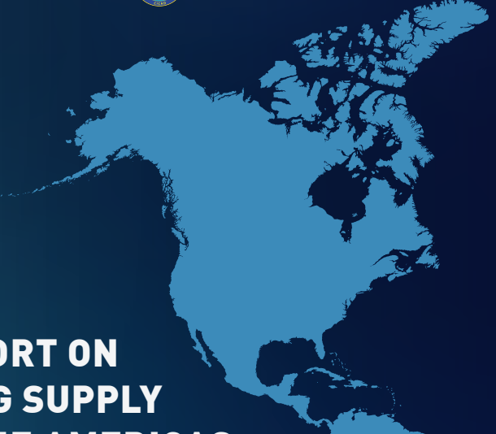
Cannabis
Cannabis was the only drug whose illicit supply was mentioned by every member state that provided data.
Cannabis eradication declined between 2016-2019.
Hectares
Plants
Notes:
Cannabis eradication declined between 2016 and 2019, primarily based on data from North America. Countries using hectares as their metric for eradication reported a decline of about 50%. Similarly, countries using the total number of plants eradicated as their metric reported a decline between 2016 and 2018—of around 40% (approximately five million to just under three million plants, and then an increase to approximately four million plants) then an increase in 2019. So, a total decline of about 20%

Slide 11
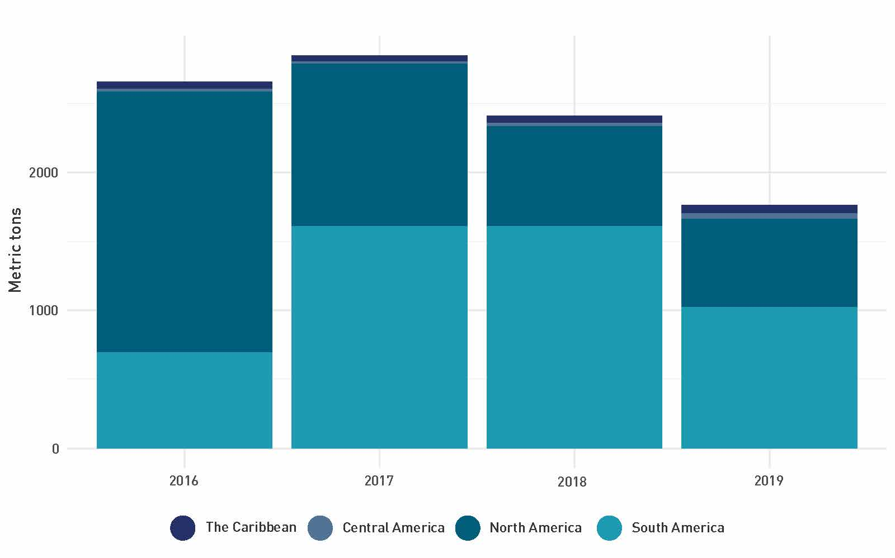
Cannabis
Avg. Seizure weight
Cannabis seizures larger than other illicit drugs.
Caribbean reported the largest average cannabis seizure weight, followed by South America.
5Kg
South America
10Kg
Caribbean
Metric tons of cannabis herb seized by subregion and year
Total cannabis seizures fell in North America and remained stable for the Caribbean and Central America. South America was less clear with a rise until 2017, followed by a decline in 2019.
Notes:
Historically, North America has reported larger total seizures of cannabis, driven mainly by seizures in the United States; however, between 2016 and 2019, cannabis seizures fell in North America, while remaining stable for the Caribbean and Central America. In South America,, the trend is less clear, with seizures increasing from 694 MT in 2016 to over 1,600 MT in 2017, then dropping to 1,000 MT in 2019.
Similarly, when measured by average weight, seizures of cannabis were larger than those of all other all illicit drugs in the Americas between 2016 and 2019. Sub-regionally, the Caribbean reported the largest average cannabis seizure weight, of almost 10kg. South America had the next largest average seizure weight at around 5kg.
Qualitative data regarding cannabis highlighted the importance cannabis production plays in the Caribbean, the rise of transnational cannabis trafficking in South America, innovations in cannabis trafficking in Central America, and a decrease in marijuana seizures in North America.

Slide 12
Cocaine trends
Total cocaine seizures rose from about 800 MT in 2016 to nearly 1,000 MT in 2019.
South America
590 MT to 650 MT
In North America
220 MT to 270 MT
Qualitative data indicated:
enhanced processing methods
increased lab capacity
an uptick of labs to manufacture precursor chemicals
new strains of coca leaf with longer productive lives
Notes:
Cocaine trends: toatla seizure rose
Qualitative data identified cocaine as a drug of concern throughout the Americas and highlighted trafficking patterns. The Bahamas, Guatemala, Honduras, Trinidad and Tobago, and the United States reported on domestic consumer markets for cocaine or crack cocaine. Reporting also focused on the high prevalence of containerized shipments of cocaine destined for North American and European markets.
Average cocaine seizure weights varied. The largest average seizure weights were in Central America, at around 25 to 30kg. South America followed, with average seizure weights rising from about two to 10kg over the same four-year period. Average seizure weights in North America remained below 10kg each year. The Caribbean had the most fluctuation, with annual seizure weights ranging from just over 1.5kg to nearly 16kg.

Slide 13
Heroin and Synthetic Opioid trends
Heroin: The heroin trade in the Americas is mainly intra-regional, nearly all the heroin produced is destined for markets in the Hemsiphere.
Quantitative data on heroin came primarily from North America.
Fentanyl: Information on fentanyl came from North America only.
Concerns about fentanyl trafficking and heroin increasingly laced with fentanyl.
While the synthetic fentanyl market is concentrated in North America, potential exists that it could proliferate to other countries.
Notes:
Fentanyl has had a greater impact on countries in North America. The trafficking of illicit fentanyl, and other opioids into the United States and Canada has fueled national epidemics with fatal consequences.
In 2019 approximately 3,580 kg of fentanyl were seized in North America.
Compared with 270 metric tons of cocaine and 600 metric tons of cannabis
FOR YOUR TALKING POINTS
Recent trends in the USA suggest that the price of fentanyl has been dropping, and it is being mixed with other drugs like heroin and cocaine. Users have been buying cocaine unaware that the cocaine contains fentanyl, and this has driven up overdose case numbers.

Slide 14
Methamphetamine trends
Methamphetamine is the most common synthetic drug in the region.
Market remains concentrated in North America; however, production has shifted south into Mexico.
Methamphetamine seizures have increased proportionally more than any other drug seized.
Indicators on meth laboratory seizures suggest that individual laboratories are producing more.
Early warning systems are a valuable tool for identifying the spread of synthetic drugs and other novel substances in the region

Slide 15
New Challenges for Drug Policy

Slide 16
Marya Hynes
Inter-American Observatory on Drugs (OID)
Inter-American Drug Abuse Control Commision (CICAD)
mhynes@oas.org
Twitter @CICAD_OEA
www.cicad.oas.org

